Slide 1


Istio on Kubernetes: Enter the Service Mesh
rafael.benevides@oracle.com
@rafabene
Link
http://bit.ly/istio-kubernetes
@rafabene

Slide 2



Rafael Benevides
Cloud-Native Development Advocate
rafael.benevides@oracle.com
@rafabene
Java Certifications:
SCJA / SCJP / SCWCD / SCBCD / SCEA
JBoss Certifications:
JBCD / JBCAA
Red Hat Certifications:
OpenShift / Containers / Ansible
Other Certifications:
SAP Netweaver / ITIL / IBM Software Quality
Notes:
We have a new group at Red Hat, started in January

Slide 3
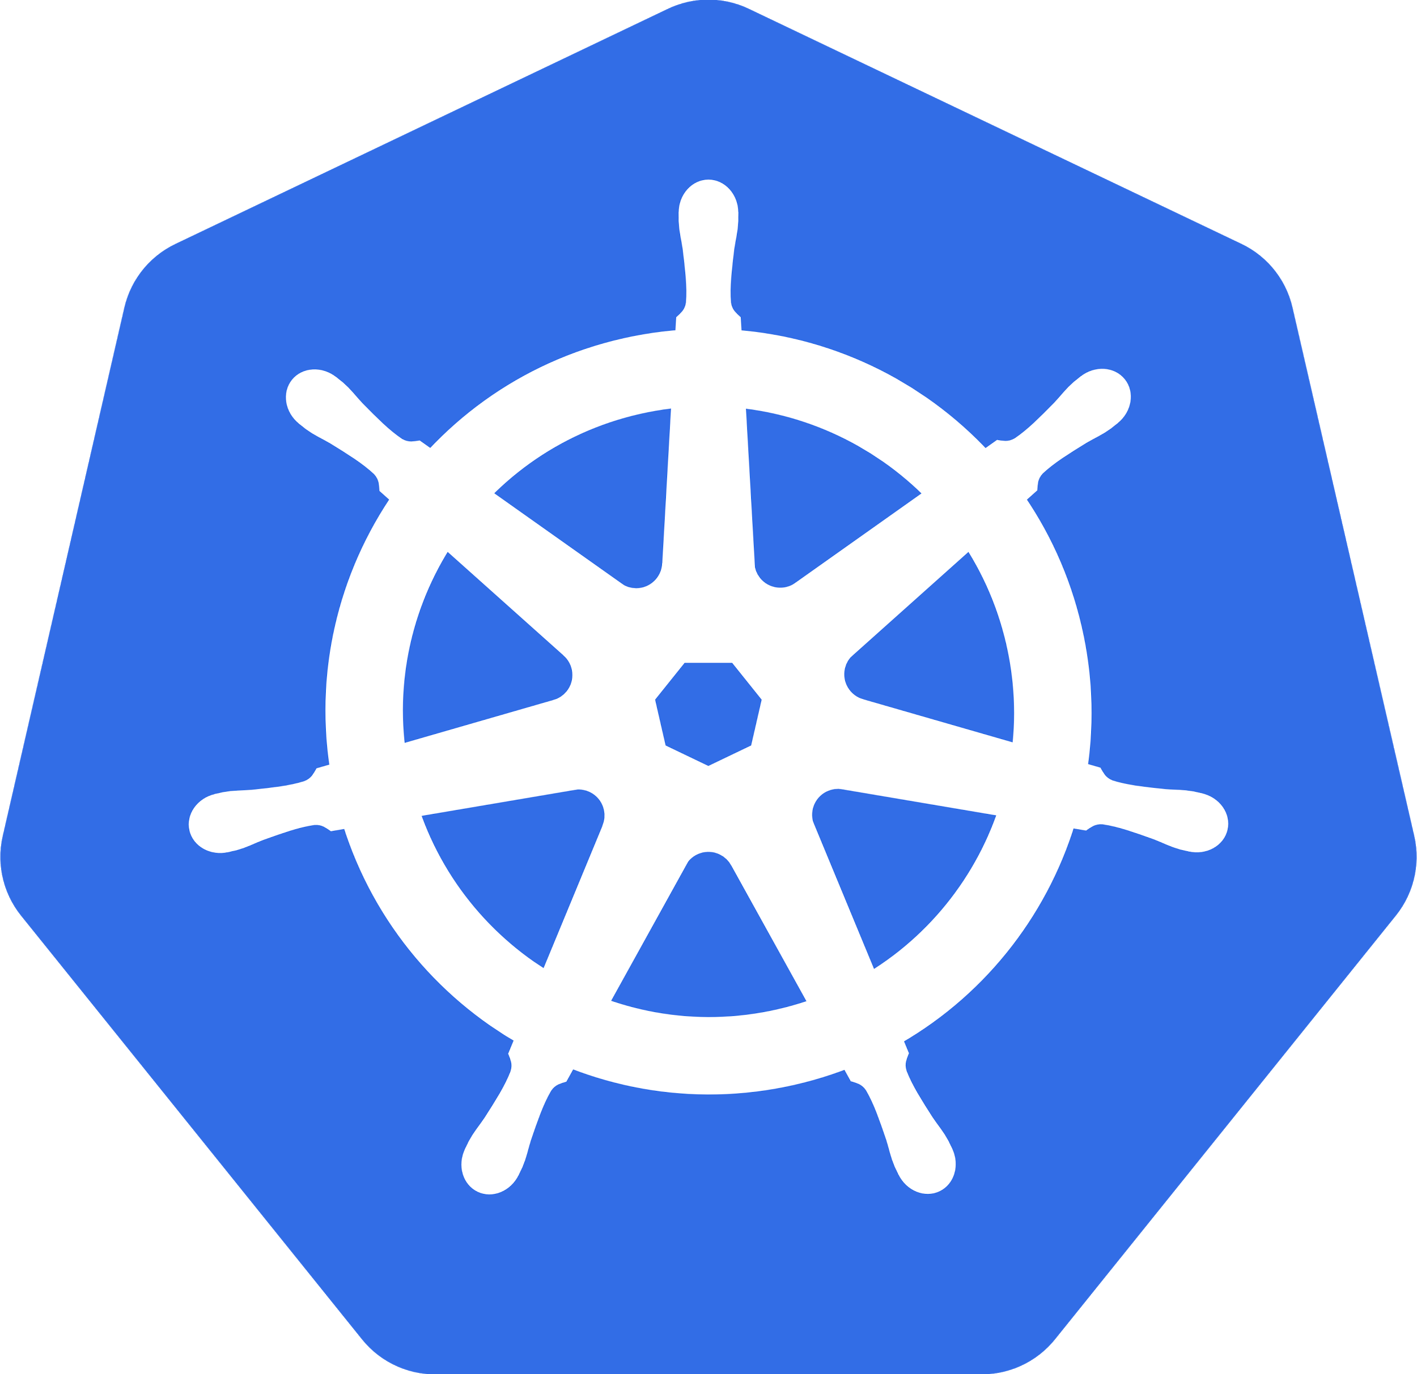







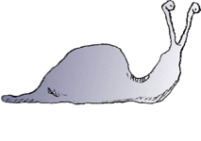

Your Journey to Awesomeness
Re-Org to
DevOps
Self-Service,
On-Demand,
Elastic Infrastructure
Automation
CI & CD
Deployment Pipeline
Advanced
Deployment
Techniques
Microservices

Slide 4
Monolith
MyApp
@rafabene - http://bit.ly/istio-kubernetes

Slide 5
Modules
@rafabene - http://bit.ly/istio-kubernetes

Slide 6
Microservices
@rafabene - http://bit.ly/istio-kubernetes

Slide 7
Microservices
@rafabene - http://bit.ly/istio-kubernetes

Slide 8
Microservices
@rafabene - http://bit.ly/istio-kubernetes

Slide 9
Microservices
@rafabene - http://bit.ly/istio-kubernetes

Slide 10
Microservices
@rafabene - http://bit.ly/istio-kubernetes

Slide 11
Network of Services - Mesh
@rafabene - http://bit.ly/istio-kubernetes

Slide 12
Microservices own their Data
@rafabene - http://bit.ly/istio-kubernetes

Slide 13
Multiple Points of Entry
@rafabene - http://bit.ly/istio-kubernetes

Slide 14

Multiple Pipelines
@rafabene - http://bit.ly/istio-kubernetes

Slide 15

Microservices Principles
Deployment Independence - updates to an individual microservice have no negative impact to any other component of the system. Optimized for Replacement
Organized around business capabilities
Products not Projects
API Focused
Smart endpoints and dumb pipes
Decentralized Governance
Decentralized Data Management
Infrastructure Automation (infrastructure as code)
Design for failure
Evolutionary Design
2 Pizza Team

Slide 16
Old School New School
Love Thy Mono

Slide 17
Microservices == Distributed Computing
OS
OS
JVM
JVM
Service A
Service C
OS
JVM
Service B

Slide 18
Fallacies of Distributed Computing
The Network is Reliable
Latency is zero
Bandwidth is infinite
Topology does not change
There is one administrator
Transport cost is zero
The network is homogeneous
https://en.wikipedia.org/wiki/Fallacies_of_distributed_computing

Slide 19
Failure of a Service
X
@rafabene

Slide 20
Cascading Failure
X
X
X
X
X
X
X
@rafabene

Slide 21
Microservices embedding Capabilities
Container
Container
JVM
JVM
Service A
Service C
Discovery
Discovery
Load-balancer
Load-balancer
Resiliency
Resiliency
Metrics
Metrics
Tracing
Tracing
Container
JVM
Service B
Discovery
Load-balancer
Resiliency
Metrics
Tracing

Slide 22
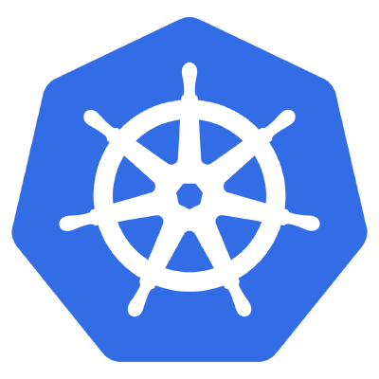
History of Microservices
AWS EC2
2006
Java EE6
2009
DropWizard
May 2011
Hystrix
March 2012
Eureka
July 2012
Spring Boot
Sept 2013
Kubernetes
June 2014
2
0
1
5
Continuous
Integration
via XP
1999
DevOps
2009
NETFLIX
to AWS
2010
Agile
Manifesto
Feb
2001
Vert.x
June 2011
Ribbon
March 2012
Microservices
Assess
Thoughtworks
Radar
March 2012
Docker
March
2013
Microservices
Defined
Thoughtworks
Fowler, Lewis
March 2014
Notes:
https://www.infoq.com/presentations/SpringOne-2GX-Keynote-Next-Generation-Applications (advance to 1:05)
http://redmonk.com/sogrady/2014/03/27/micro-services/
https://www.slideshare.net/adriancockcroft/speeding-up-31799721
https://en.wikipedia.org/wiki/Java_EE_version_history#Java_EE_6_.28December_10.2C_2009.29
https://assets.thoughtworks.com/assets/technology-radar-march-2012.pdf
Netflix and Kubernetes https://www.youtube.com/watch?v=57UK46qfBLY&feature=youtu.be&t=37m21s
https://thenewstack.io/github-goes-kubernetes-tells/
Docker born March 2013
https://www.youtube.com/watch?v=9xciauwbsuo
DropWizard History
https://github.com/dropwizard/dropwizard/commit/7d4cf121fe5fc560b5ae1a7465adea28451124e6
Vert.x History
https://en.wikipedia.org/wiki/Vert.x

Slide 23
The Cloud is Born
AWS EC2
2006
Java EE6
2009
DropWizard
May 2011
Hystrix
March 2012
Eureka
July 2012
Spring Boot
Sept 2013
Kubernetes
June 2014
2
0
1
5
Continuous
Integration
via XP
1999
DevOps
2009
NETFLIX
to AWS
2010
Agile
Manifesto
Feb
2001
Vert.x
June 2011
Ribbon
March 2012
Microservices
Assess
Thoughtworks
Radar
March 2012
Docker
March
2013
Microservices
Defined
Thoughtworks
Fowler, Lewis
March 2014
Notes:
https://www.infoq.com/presentations/SpringOne-2GX-Keynote-Next-Generation-Applications (advance to 1:05)
http://redmonk.com/sogrady/2014/03/27/micro-services/
https://www.slideshare.net/adriancockcroft/speeding-up-31799721
https://en.wikipedia.org/wiki/Java_EE_version_history#Java_EE_6_.28December_10.2C_2009.29
https://assets.thoughtworks.com/assets/technology-radar-march-2012.pdf
Netflix and Kubernetes https://www.youtube.com/watch?v=57UK46qfBLY&feature=youtu.be&t=37m21s
https://thenewstack.io/github-goes-kubernetes-tells/
Docker born March 2013
https://www.youtube.com/watch?v=9xciauwbsuo
DropWizard History
https://github.com/dropwizard/dropwizard/commit/7d4cf121fe5fc560b5ae1a7465adea28451124e6
Vert.x History
https://en.wikipedia.org/wiki/Vert.x

Slide 24
Fat Jars
AWS EC2
2006
Java EE6
2009
DropWizard
May 2011
Hystrix
March 2012
Eureka
July 2012
Spring Boot
Sept 2013
Kubernetes
June 2014
2
0
1
5
Continuous
Integration
via XP
1999
DevOps
2009
NETFLIX
to AWS
2010
Agile
Manifesto
Feb
2001
Vert.x
June 2011
Ribbon
March 2012
Microservices
Assess
Thoughtworks
Radar
March 2012
Docker
March
2013
Microservices
Defined
Thoughtworks
Fowler, Lewis
March 2014
Notes:
https://www.infoq.com/presentations/SpringOne-2GX-Keynote-Next-Generation-Applications (advance to 1:05)
http://redmonk.com/sogrady/2014/03/27/micro-services/
https://www.slideshare.net/adriancockcroft/speeding-up-31799721
https://en.wikipedia.org/wiki/Java_EE_version_history#Java_EE_6_.28December_10.2C_2009.29
https://assets.thoughtworks.com/assets/technology-radar-march-2012.pdf
Netflix and Kubernetes https://www.youtube.com/watch?v=57UK46qfBLY&feature=youtu.be&t=37m21s
https://thenewstack.io/github-goes-kubernetes-tells/
Docker born March 2013
https://www.youtube.com/watch?v=9xciauwbsuo
DropWizard History
https://github.com/dropwizard/dropwizard/commit/7d4cf121fe5fc560b5ae1a7465adea28451124e6
Vert.x History
https://en.wikipedia.org/wiki/Vert.x

Slide 25
Netflix goes Open Source
AWS EC2
2006
Java EE6
2009
DropWizard
May 2011
Hystrix
March 2012
Eureka
July 2012
Spring Boot
Sept 2013
Kubernetes
June 2014
2
0
1
5
Continuous
Integration
via XP
1999
DevOps
2009
NETFLIX
to AWS
2010
Agile
Manifesto
Feb
2001
Vert.x
June 2011
Ribbon
March 2012
Microservices
Assess
Thoughtworks
Radar
March 2012
Docker
March
2013
Microservices
Defined
Thoughtworks
Fowler, Lewis
March 2014
Notes:
https://www.infoq.com/presentations/SpringOne-2GX-Keynote-Next-Generation-Applications (advance to 1:05)
http://redmonk.com/sogrady/2014/03/27/micro-services/
https://www.slideshare.net/adriancockcroft/speeding-up-31799721
https://en.wikipedia.org/wiki/Java_EE_version_history#Java_EE_6_.28December_10.2C_2009.29
https://assets.thoughtworks.com/assets/technology-radar-march-2012.pdf
Netflix and Kubernetes https://www.youtube.com/watch?v=57UK46qfBLY&feature=youtu.be&t=37m21s
https://thenewstack.io/github-goes-kubernetes-tells/
Docker born March 2013
https://www.youtube.com/watch?v=9xciauwbsuo
DropWizard History
https://github.com/dropwizard/dropwizard/commit/7d4cf121fe5fc560b5ae1a7465adea28451124e6
Vert.x History
https://en.wikipedia.org/wiki/Vert.x

Slide 26
Perfect Storm for Microservices
AWS EC2
2006
Java EE6
2009
DropWizard
May 2011
Hystrix
March 2012
Eureka
July 2012
Spring Boot
Sept 2013
Kubernetes
June 2014
2
0
1
5
Continuous
Integration
via XP
1999
DevOps
2009
NETFLIX
to AWS
2010
Agile
Manifesto
Feb
2001
Vert.x
June 2011
Ribbon
March 2012
Microservices
Assess
Thoughtworks
Radar
March 2012
Docker
March
2013
Microservices
Defined
Thoughtworks
Fowler, Lewis
March 2014
Notes:
https://www.infoq.com/presentations/SpringOne-2GX-Keynote-Next-Generation-Applications (advance to 1:05)
http://redmonk.com/sogrady/2014/03/27/micro-services/
https://www.slideshare.net/adriancockcroft/speeding-up-31799721
https://en.wikipedia.org/wiki/Java_EE_version_history#Java_EE_6_.28December_10.2C_2009.29
https://assets.thoughtworks.com/assets/technology-radar-march-2012.pdf
Netflix and Kubernetes https://www.youtube.com/watch?v=57UK46qfBLY&feature=youtu.be&t=37m21s
https://thenewstack.io/github-goes-kubernetes-tells/
Docker born March 2013
https://www.youtube.com/watch?v=9xciauwbsuo
DropWizard History
https://github.com/dropwizard/dropwizard/commit/7d4cf121fe5fc560b5ae1a7465adea28451124e6
Vert.x History
https://en.wikipedia.org/wiki/Vert.x

Slide 27

What's Wrong with Netflix OSS?
Java Only
Adds a lot of libraries to YOUR code

Slide 28




Microservices'ilities
API
Tracing
Discovery
Monitoring
Invocation
MyService
Logging
Elasticity
Authentication
Resilience
Pipeline

Slide 29

Open Source

Slide 30
Microservices'ilities + Kubernetes
API
Tracing
Discovery
Monitoring
Invocation
MyService
Logging
Elasticity
Authentication
Resilience
Pipeline

Slide 31




Microservices'ilities + Open Source
API
Tracing
Discovery
Monitoring
Invocation
MyService
Logging
Elasticity
Authentication
Resilience
Pipeline

Slide 32
Istio - Sail
(Kubernetes - Helmsman or ship’s pilot)

Slide 33
Service Mesh Defined
A service mesh is a dedicated infrastructure layer for handling service-to-service communication. It’s responsible for the reliable delivery of requests through the complex topology of services that comprise a modern, cloud native application. In practice, the service mesh is typically implemented as an array of lightweight network proxies that are deployed alongside application code, without the application needing to be aware
https://buoyant.io/2017/04/25/whats-a-service-mesh-and-why-do-i-need-one/

Slide 34

Microservices'ilities + Open Source + Istio
API
Tracing
Discovery
Monitoring
Invocation
MyService
Logging
Elasticity
Authentication
Resilience
Pipeline

Slide 35
Microservices embedding Capabilities
Container
Container
JVM
JVM
Service A
Before Istio
Service C
Discovery
Discovery
Load-balancer
Load-balancer
Resiliency
Resiliency
Metrics
Metrics
Tracing
Tracing
Container
JVM
Service B
Discovery
Load-balancer
Resiliency
Metrics
Tracing

Slide 36
Microservices externalizing Capabilities
Pod
Pod
Container
Container
JVM
JVM
Service A
After Istio
Service C
Sidecar Container
Sidecar Container
Pod
Container
JVM
Service B
Sidecar Container

Slide 37
Microservices externalizing Capabilities
Pod
Pod
Container
Container
JVM
JVM
Service A
After Istio
Service C
The sidecar intercepts all network traffic
Sidecar Container
Sidecar Container
Pod
Sidecar Container
Container
JVM
Service B

Slide 38

Envoy is the current sidecar
Pod
Pod
Container
Container
JVM
JVM
Service A
Service C
Sidecar Container
Sidecar Container
Pod
Sidecar Container
Container
JVM
Service B

Slide 39

Sidecar
https://www.imz-ural.com/blog/waffles-the-sidecar-dog
Notes:
https://kubernetes.io/blog/2015/06/the-distributed-system-toolkit-patterns/

Slide 40
Next Generation Microservices - Service Mesh
Code Independent (Polyglot)
Intelligent Routing and Load-Balancing
A/B Tests
Smarter Canary Releases
Chaos: Fault Injection
Resilience: Circuit Breakers
Observability: Metrics and Tracing
Fleet wide policy enforcement

Slide 41
Istio Data Plane vs Control Plane
Data
Plane
Pod
Pod
Pod
Container
Container
Container
JVM
JVM
JVM
HTTP1.1, HTTP2, gRPC, TCP w/TLS
Service A
HTTP1.1, HTTP2, gRPC, TCP w/TLS
Service B
HTTP1.1, HTTP2, gRPC, TCP w/TLS
Service C
Envoy Sidecar
Envoy Sidecar
Envoy Sidecar
Control
Plane
Istio Pilot
Istio Mixer
Istio Galey
Istio Citadel
istioctl, API, config
Quota, Telemetry Rate Limiting, ACL
Validation
mTLS, SPIFFE

Slide 42











Polyglot Microservices Platform circa 2019
Jaeger
Istio
NETFLIX Ribbon

Slide 43
Observability

Slide 44
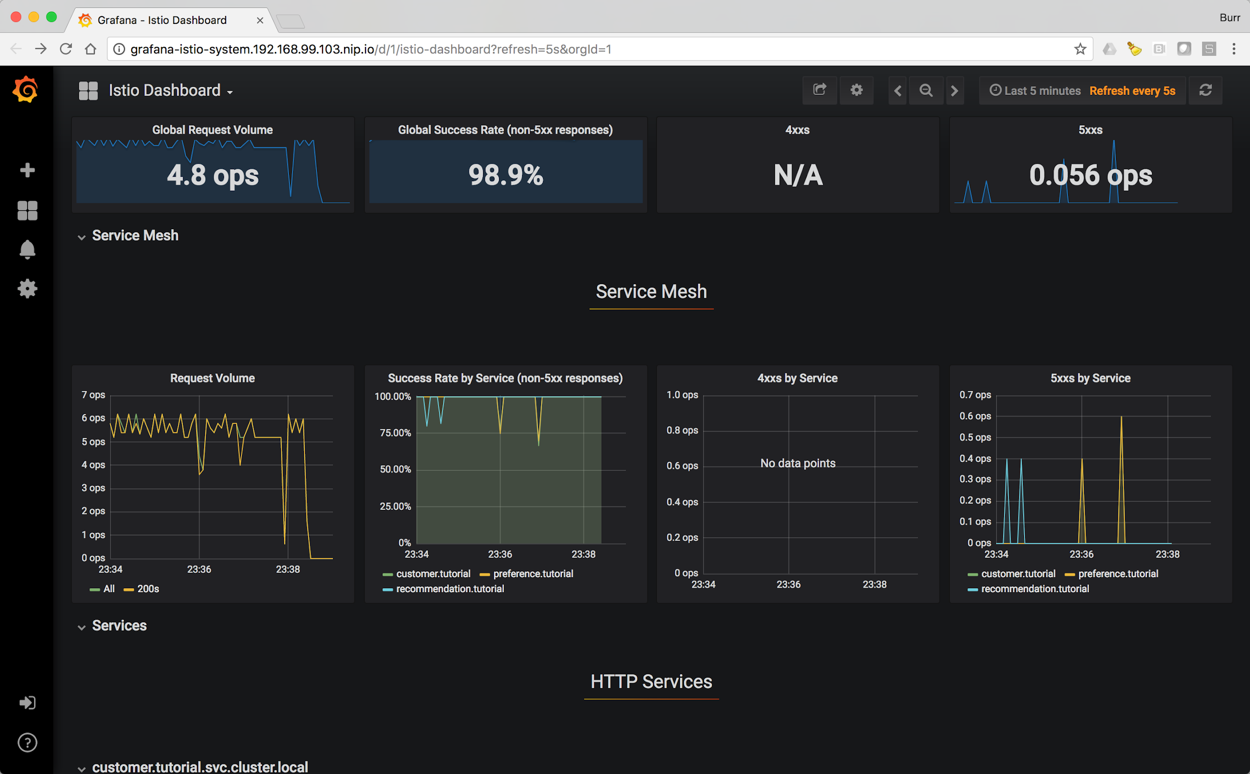

Slide 45
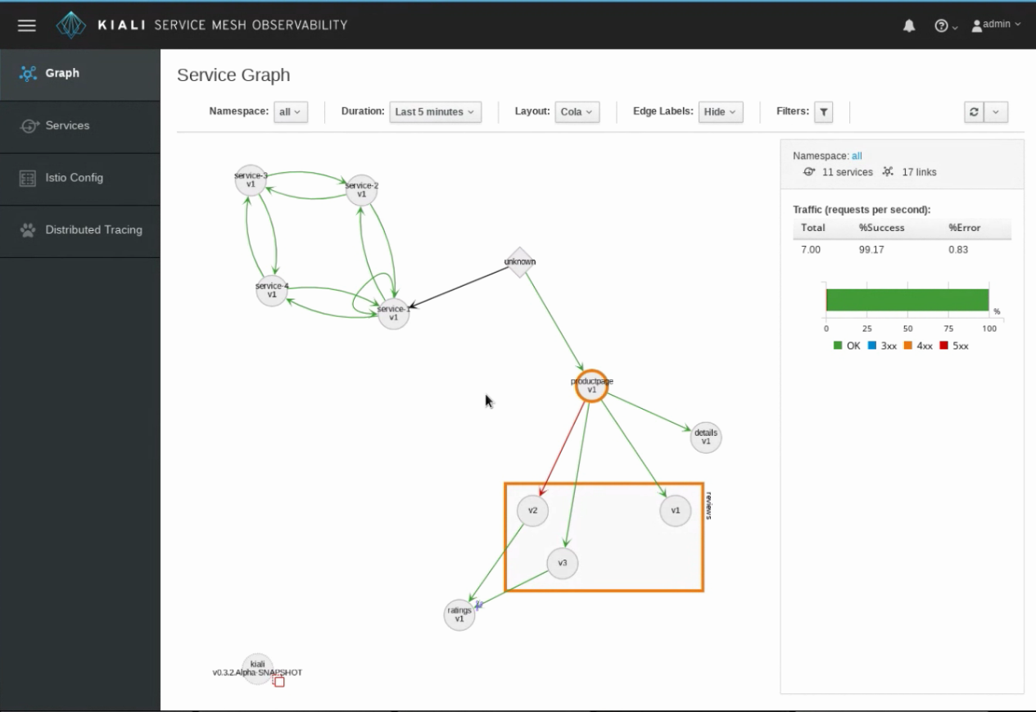
Kiali.io
New Service Graph

Slide 46
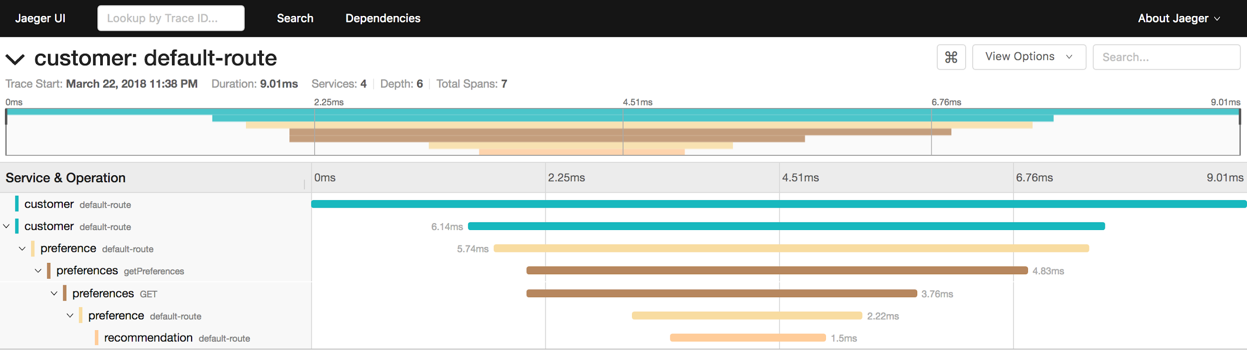

Slide 47
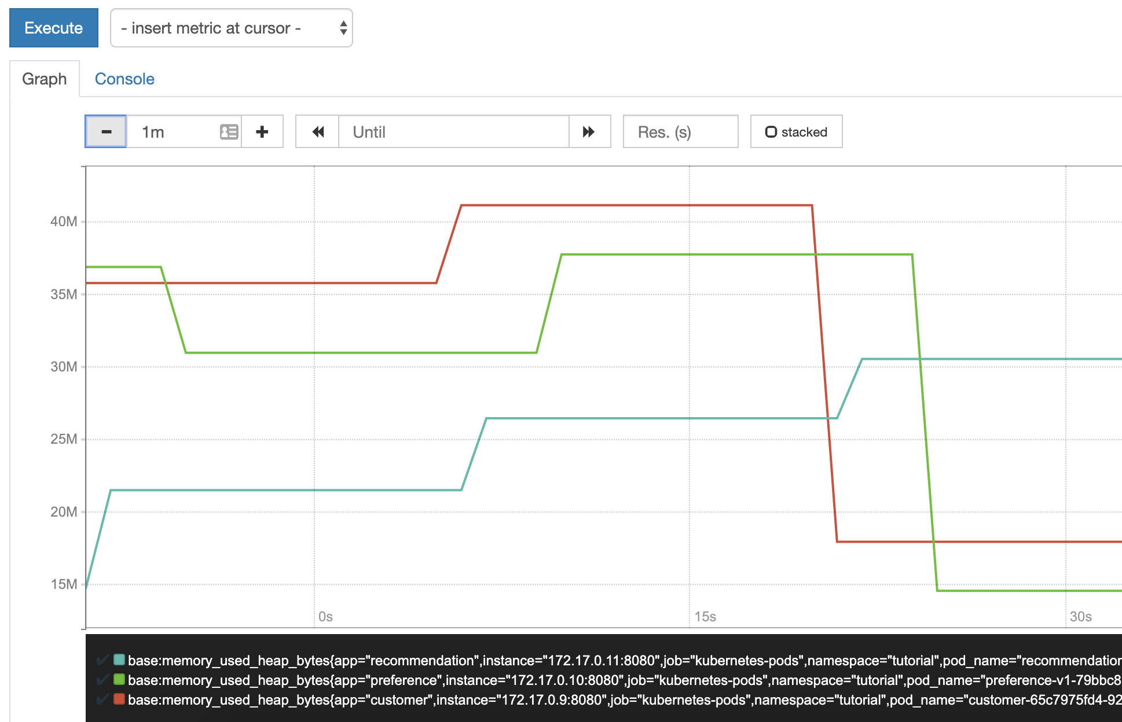
Prometheus

Slide 48
How to add an Istio-Proxy (sidecar)?
istioctl kube-inject -f NormalDeployment.yaml
OR
kubectl label namespace tutorial istio-injection=enabled
To "see" the sidecar:
kubectl describe deployment customer
Notes:
Add named service port for each service port
Declare containerPort configuration for each pod port
Pod must have a service associated
Label deployments with app and version
Don't use UID 1337
NET_ADMIN privilege

Slide 49
Traffic Control

Slide 50
Blue/Green Deployment

Slide 51
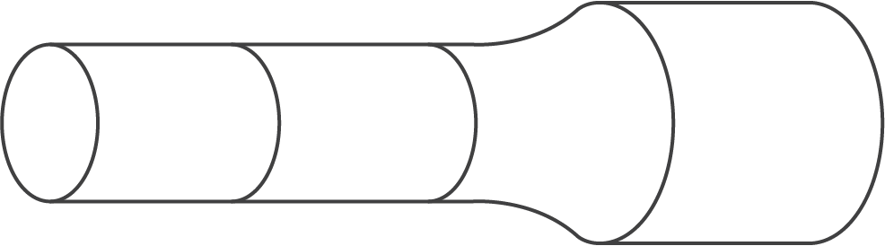



Blue/Green Deployment
BUILD
SCM
DEVELOPMENT
QA
STAGING
PRODUCTION
ROUTER
USERS

Slide 52
Blue/Green Deployment
BUILD
SCM
DEVELOPMENT
QA
STAGING
PRODUCTION
ROUTER
USERS

Slide 53
Blue/Green Deployment
BUILD
SCM
DEVELOPMENT
QA
STAGING
PRODUCTION
ROUTER
USERS

Slide 54
Blue/Green Deployment
BUILD
SCM
DEVELOPMENT
QA
STAGING
PRODUCTION
ROUTER
USERS

Slide 55
Blue/Green Deployment
SCM
BUILD
DEVELOPMENT
QA
STAGING
PRODUCTION
ROUTER
USERS

Slide 56
Blue/Green Deployment
SCM
DEVELOPMENT
QA
STAGING
PRODUCTION
ROUTER
USERS

Slide 57
Blue/Green Deployment
SCM
x
DEVELOPMENT
QA
STAGING
PRODUCTION
ROUTER
USERS

Slide 58
Blue/Green Deployment
SCM
DEVELOPMENT
QA
STAGING
PRODUCTION
ROUTER
USERS

Slide 59
Demo Blue/Green
Only Recommendation-v2
Only Recommendation-v1
Both (Delete Rule)

Slide 60
Canary
Deployment

Slide 61
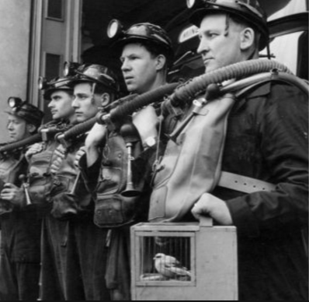
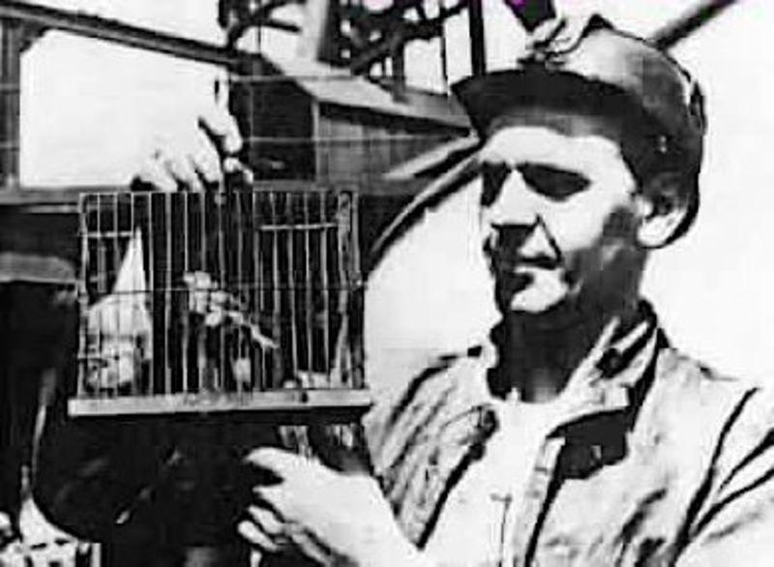


Slide 62
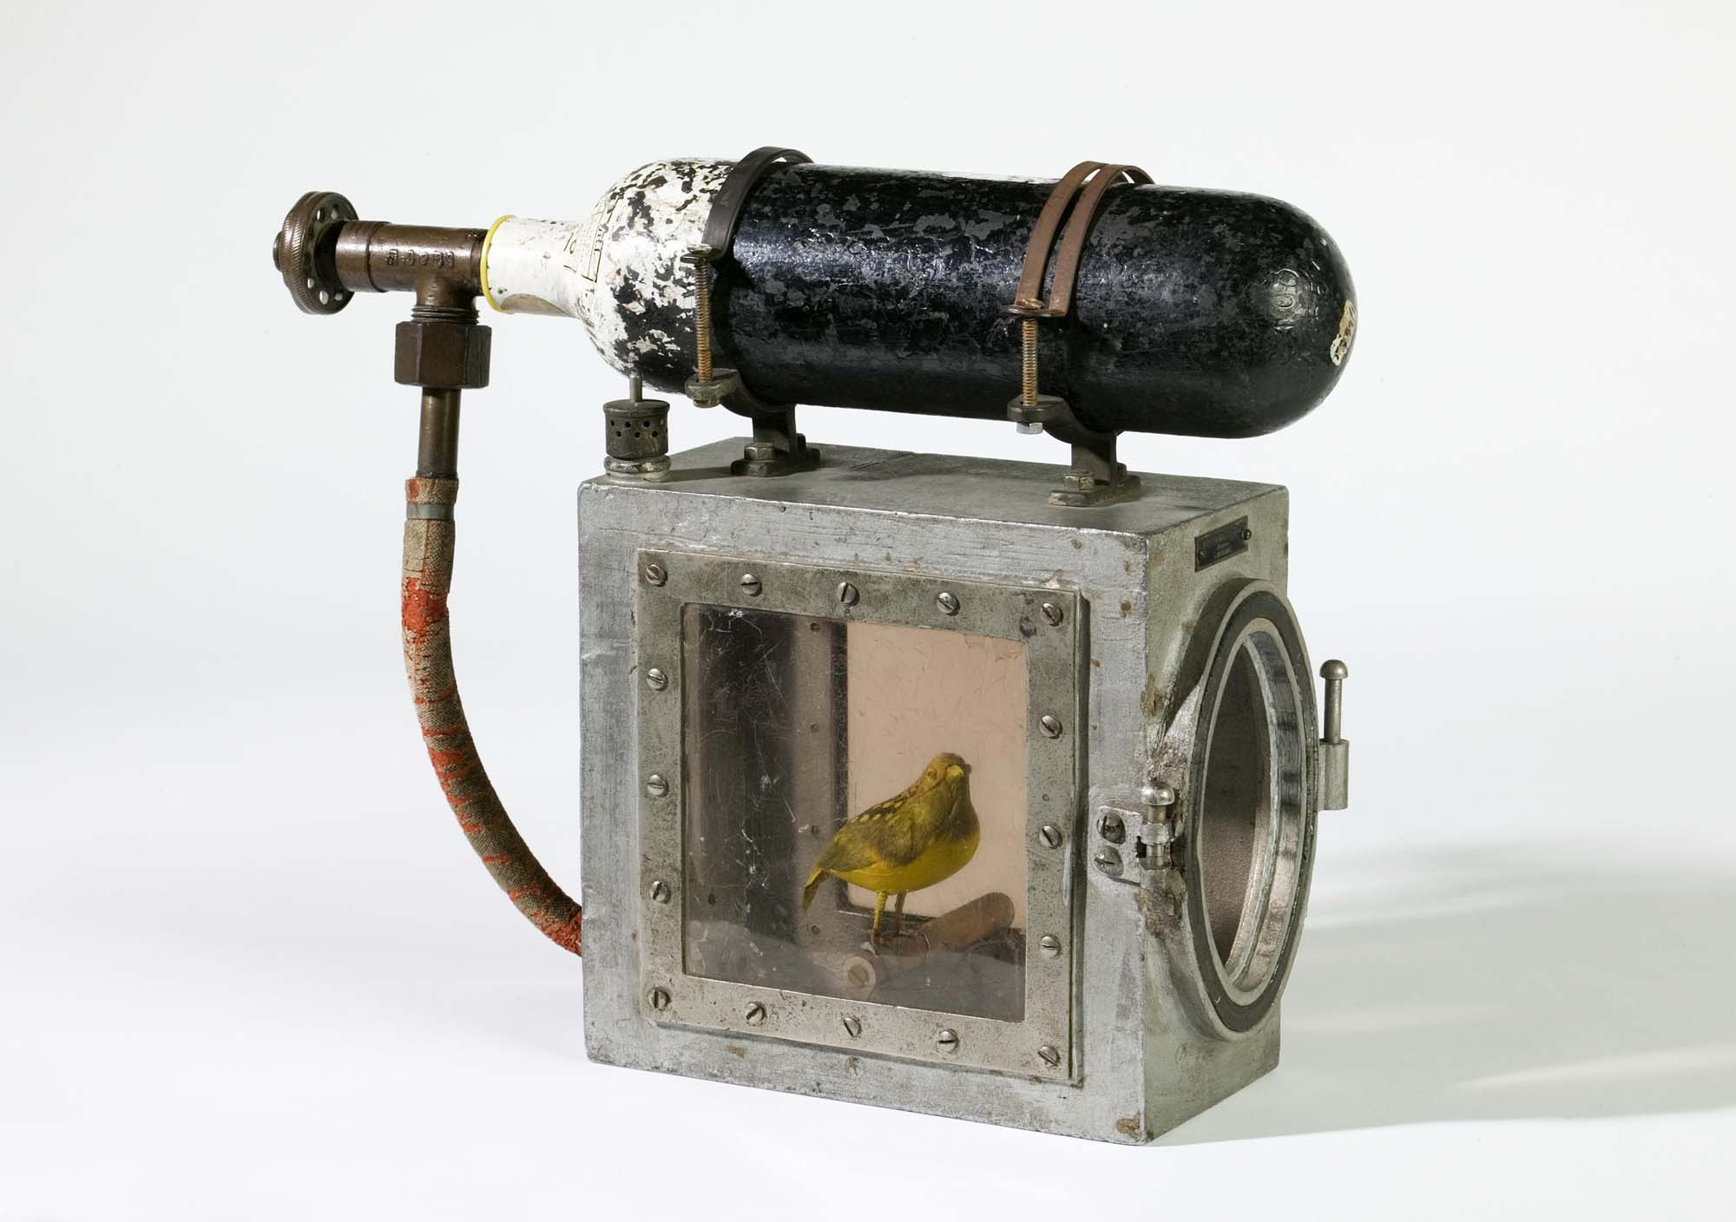
Canary Resuscitator
http://www.openculture.com/2018/05/the-device-invented-to-resuscitate-canaries-in-coal-mines-circa-1896.html
Thanks to Paolo Antinori!

Slide 63
Canary Deployment
SCM
DEVELOPMENT
QA
STAGING
PRODUCTION
ROUTER
USERS

Slide 64
Canary Deployment
SCM
DEVELOPMENT
QA
STAGING
PRODUCTION
ROUTER
USERS

Slide 65
Canary Deployment
SCM
DEVELOPMENT
QA
STAGING
PRODUCTION
ROUTER
USERS

Slide 66
Canary Deployment
SCM
DEVELOPMENT
QA
STAGING
PRODUCTION
ROUTER
USERS

Slide 67
Canary Deployment
SCM
DEVELOPMENT
QA
STAGING
PRODUCTION
ROUTER
USERS

Slide 68
Canary Deployment
SCM
DEVELOPMENT
QA
STAGING
PRODUCTION
ROUTER
USERS

Slide 69
Canary Deployment
SCM
DEVELOPMENT
QA
STAGING
PRODUCTION
ROUTER
USERS

Slide 70
Canary Deployment
SCM
DEVELOPMENT
QA
STAGING
PRODUCTION
ROUTER
USERS

Slide 71
Canary Deployment
SCM
DEVELOPMENT
QA
STAGING
PRODUCTION
ROUTER
USERS

Slide 72
Canary Deployment
SCM
DEVELOPMENT
QA
STAGING
PRODUCTION
ROUTER
USERS

Slide 73

Canaries with Kubernetes
Pod
Container
JVM
50%
Service A v1
Route/
Ingress
Service
Pod
Container
JVM
Service A v2
50%

Slide 74
Canaries with Istio
Pod
Container
JVM
90%
Service A v1
Route/
Ingress
Service
Pod
Container
JVM
Service A v2
10%

Slide 75
Demo Canary
90/10
75/25
Based on User-Agent

Slide 76

Dark
Launch

Slide 77

Dark Launches with Istio
Pod
Container
JVM
100%
Service A v1
Mirror requests
Route/
Ingress
Service
Pod
Container
JVM
Service A v2
100%
@rafabene

Slide 78
Demo Dark Launch

Slide 79
Service Resiliency
Retry
Kiali
X
X
X
X
X
X
X

Slide 80
Chaos Testing

Slide 81

By Netflix - https://github.com/Netflix/SimianArmy/blob/master/assets/SimianArmy.png, Apache License 2.0, https://commons.wikimedia.org/w/index.php?curid=63503083
Notes:
By Netflix - https://github.com/Netflix/SimianArmy/blob/master/assets/SimianArmy.png, Apache License 2.0, https://commons.wikimedia.org/w/index.php?curid=63503083

Slide 82
Demo Caos
Delay

Slide 83
Access Control
Pod
Pod
Pod
Customer
Preference
Recommendation
✓
✓
istio-proxy
istio-proxy
istio-proxy

Slide 84
Most Communication Inbound & Internal

Slide 85
Outbound/Egress Blocked
✓

Slide 86
Demo Egress
Access http://worldclockapi.com

Slide 87
Demo
rafabene.com/istio-tutorial

Slide 88












Run them on Linux
Master
Ingress Gateway
Dev
API Server
Node
Node
Node
SCM (Git/Svn)
Kubernetes
CI/CD
Automation
Controllers
- Scheduler
- Replication
- Services
- Builds
- Routes
- Deployment
Oracle Linux
Physical
Virtual
Private
Public
Ops

Slide 89
The End
(but Serverless is coming)

Slide 90
@RAFABENE
@rafabene

